Slide 1
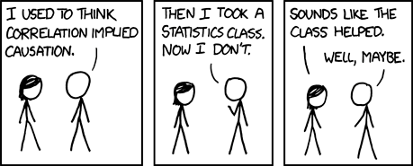
Research Methods, 205
Professor Paul J. Reber, PhD.
TA: Zixin Zeng & Grace Coram

Slide 2
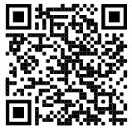
Experiment 1
QR code
Should work on mobile devices…
Link on canvas
https://tinyurl.com/Reber205
https://www.reberlab.org/file/show/Memory205.html?group=c0ff24d7a593fce6

Slide 3
What was this experiment about?
What was the independent variable?
What was the dependent variable?
State a hypothesis relating the independent variable to the dependent variable
What statistical test would we use to establish a reliable relationship between our independent and dependent variables that would allow us to test our hypothesis?

Slide 4
How Do They Know That?
Free textbook in development for this class
Chapters 1-7 available now as pdf on Canvas
The rest will be posted soon, probably in thirds
20 chapters total
A Hands-on Approach to Research Methods
Pros: free, well-synchronized with classroom content
Second class so far, so hopefully getting better
Cons: typos, probably a bit rough in places, potential redundancies as content is edited
Help with content will get you added to acknowledgments

Slide 5
Class overview
Experimental Research Methods
Classroom:
Definitions, technique, discussion
Daily homework, 2 “Midterm” Exams (no Final Exam)
Hands on research
Experiment 1: you participate, analyze, write up (brief)
Experiment 2: you collect data, analyze, write up (complete)
Final project: working in small groups, carry out and write up a self-directed project

Slide 6
Rough Schedule
27 Classes
20 Chapters
2 Exams
2 Class presentations of final projects
3 classes with extra time on complicated issues, special topics
Exam 1 after Chapter 8
Exam 2 after Chapter 20

Slide 7
Class Goals: Basic research methods
Experimental design
Between/within participant designs
Factorial designs
Correlational design
Experimental statistics
Descriptive statistics: mean, standard deviation, standard error
Inferential statistics: t-test, ANOVA, correlation, chi squared
Research ethics
Fair and equitable treatment of participants
Responsible Conduct of Research

Slide 8
Critical thinking
Validity
Design logic
Interpreting results
Identifying confounds
Reliability
Statistical relationships among variables
Accuracy of operational definitions to constructs
Selection artifacts/bias
Understanding published research
Including from media report summaries

Slide 9
Reading and Presenting Research
How to read published research reports
Theory, methods, conclusions
How to write an APA-format paper
Abstract, Introduction, Methods, Results, Discussion, References,
Figures & Tables for data visualization
How to design and plan a study
Collecting data
Organizing data for analysis
Background research to present theory and conclusions
Presenting your Final Project to the class

Slide 10
Requirements & Grading
Papers, 60%
Experiment 1, 10%
Experiments 1 & 2, 20%
Including revisions of Experiment 1
Final project, 30%
Including proposal, presentation
2 Exams, 30%
Mixed in person/remote on camera
Other assignments, 10%
Daily homework, discussed in class, late submissions not accepted

Slide 11
For Friday
Read Chapter 1
HW1: Reading 1, Craik & Lockhart (1972)
This paper introduces the theoretical basis of our Experiment 1
Answer brief questions about this paper, posted to Canvas

